Slide 1
Spring Boot
Basic concept in Spring Boot

Slide 2
What is Spring?
Spring is a popular open-source framework for building Java applications that provides a wide range of features for developing robust, scalable, and maintainable applications.

Slide 3
What is Spring Boot?
Spring Boot is a framework for building and deploying stand-alone, production-grade Spring-based applications quickly and with minimal configuration. Spring boot is an extension of spring framework. It eliminates the boilerplate configuration code in our developing application.

Slide 4
Difference between Spring and Spring Boot?
Spring | Spring Boot
Spring is a modular framework for building Java applications that provides various components and modules for developing enterprise-level applications. | Spring Boot is an opinionated framework built on top of the Spring framework that provides an easy and quick way to build stand-alone, production-grade Spring applications with minimal configuration.
Spring requires manual configuration and setup for various components, such as web applications, security, and data access. | Spring Boot provides auto-configuration for many components, which reduces manual configuration and speeds up the development process.
Spring requires developers to choose and configure various dependencies and versions manually. | Spring Boot provides a pre-configured set of dependencies and versions that work together seamlessly, reducing the time and effort required for manual configuration.

Slide 5
What is Spring IOC and Dependency Injection?
Spring IoC (Inversion of Control) is a core principle of the Spring framework, which provides a way for objects to be managed by the Spring container
Dependency Injection (DI) is a design pattern that implements IoC. In a DI-based system, the objects are given their dependencies at creation time, rather than being responsible for creating or locating their own dependencies.

Slide 6
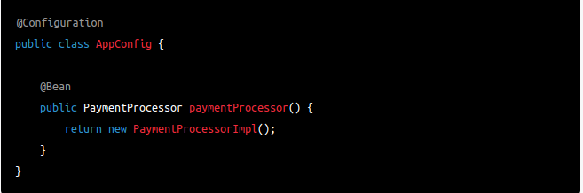
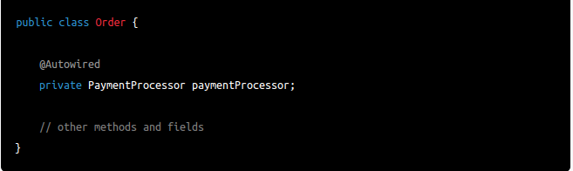
Example For Dependency Injection
Define Dependency Beans using @Bean
we use the @Autowired annotation to inject

Slide 7
What is Security Implement?
Authentication It’s the process of verifying the identity of a user or system attempting to access a resource or service.
Authorization It’s the process of granting or denying access to a resource or service based on the authenticated user's privileges and permissions.
Principle Identifying the person based on stored principle in session
Granted Authority It’s the permissions or privileges granted to an authenticated user or system to access specific resources or perform certain actions.
Roles Roles are a collection of permissions or authorities that are assigned to a specific user or group of users

Slide 8
What is Spring Security
Spring Security is a powerful and highly customizable security framework for Java-based applications.
It provides a set of features and APIs for implementing authentication, authorization, and other security mechanisms in web and enterprise applications.
Spring Security integrates well with the Spring Framework and can be easily configured and extended to meet specific application requirements.

Slide 9
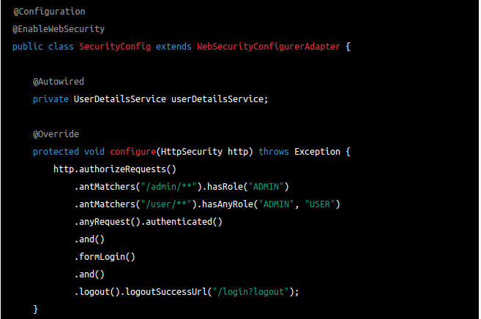
Example For Spring Security Implementation
@EnableWebSecurity is an annotation that is used to enable Spring Security in a web application. It is typically used in a configuration class that extends WebSecurityConfigurerAdapter.
WebSecurityConfigurerAdapter is an abstract class that provides a set of convenient methods for configuring Spring Security in a web application. It allows developers to customize security features such as authentication, authorization, and access control. By extending this class and overriding its methods, developers can provide their own custom security configuration for their web application.

Slide 10
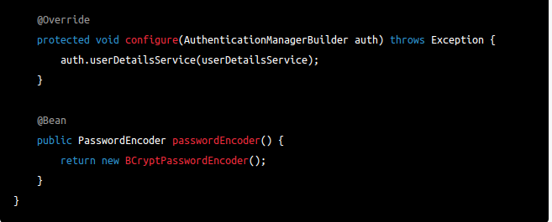
In this example, we are configuring Spring Security to require authentication and authorization for certain URLs based on user roles.
We are also specifying a custom user details service and a password encoder for password storage and verification.
This is just a basic example, and Spring Security provides many more features and options for customizing security in your application.

Slide 11
What is Hibernate?
Hibernate is a Java-based Object-Relational Mapping (ORM) framework that provides a high-level, object-oriented interface for interacting with relational databases, simplifying database access and management for developers.

Slide 12
What is JPA?
JPA stands for Java Persistence API, which is a Java specification for Object-Relational Mapping (ORM) that provides a standardized way to persist and manage data between Java objects and a relational database.

Slide 13
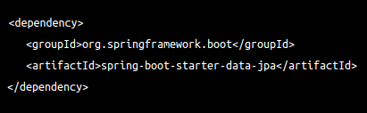
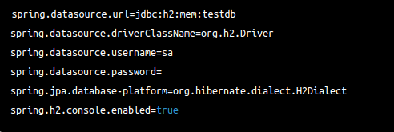
Example For Hibernate & JPA
Add dependency on pom.xml
Add database connection details in application.properties

Slide 14
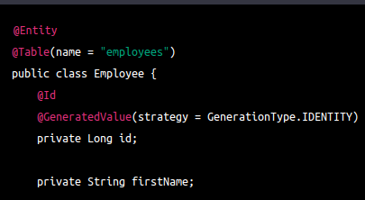

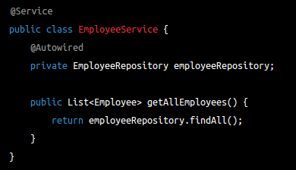
Create a @Entity class to map to a database table:
Create a @Repository interface to define database operations:
Use the repository in a Spring @Service class:

Slide 15
What is Spring Boot Hibernate Relationship Mapping?
Hibernate supports different types of relationships between entities including one-to-one, one-to-many, many-to-one, and many-to-many. These relationships can be mapped using Hibernate annotations such as @OneToOne, @OneToMany, @ManyToOne, and @ManyToMany. The specific annotations used depend on the specific use case.

Slide 16
@OneToOne Relationship Mapping
mappedBy: Specifies the field in the associated entity that owns the relationship.
cascade: Specifies the cascade type for the relationship, such as CascadeType.ALL, CascadeType.PERSIST, CascadeType.MERGE, etc.
fetch: Specifies the fetch type for the relationship, such as FetchType.EAGER or FetchType.LAZY.
optional: Specifies whether the relationship is optional or required.

Slide 17
@OneToMany Relationship Mapping
mappedBy: Specifies the field in the associated entity that owns the relationship.
cascade: Specifies the cascade type for the relationship, such as CascadeType.ALL, CascadeType.PERSIST, CascadeType.MERGE, etc.
fetch: Specifies the fetch type for the relationship, such as FetchType.EAGER or FetchType.LAZY.

Slide 18
@ManyToOne Relationship Mapping
cascade: Specifies the cascade type for the relationship, such as CascadeType.ALL, CascadeType.PERSIST, CascadeType.MERGE, etc.
fetch: Specifies the fetch type for the relationship, such as FetchType.EAGER or FetchType.LAZY.

Slide 19
@ManyToMany Relationship Mapping
mappedBy: Specifies the field in the associated entity that owns the relationship.
cascade: Specifies the cascade type for the relationship, such as CascadeType.ALL, CascadeType.PERSIST, CascadeType.MERGE, etc.
fetch: Specifies the fetch type for the relationship, such as FetchType.EAGER or FetchType.LAZY.

Slide 20
@JoinTable Relationship Mapping
Used to define a join table for a many-to-many relationship.
name: Specifies the name of the join table.
joinColumns: Specifies the foreign key column(s) in the owning entity's table that reference the join table.
inverseJoinColumns: Specifies the foreign key column(s) in the associated entity's table that reference the join table.

Slide 21
Cascade Attribute
CascadeType.ALL: When you perform an operation on the parent entity, such as inserting, updating, or deleting, the same operation is cascaded to all associated child entities.
CascadeType.PERSIST: When you perform an operation on the parent entity, such as inserting or persisting, the same operation is cascaded to all associated child entities.
CascadeType.MERGE: When you perform an operation on the parent entity, such as merging or updating, the same operation is cascaded to all associated child entities.
CascadeType.REMOVE: When you perform an operation on the parent entity, such as deleting, the same operation is cascaded to all associated child entities.
CascadeType.DETACH: When you perform an operation on the parent entity, such as detaching, the same operation is cascaded to all associated child entities.
CascadeType.REFRESH: When you perform an operation on the parent entity, such as refreshing, the same operation is cascaded to all associated child entities.

Slide 22
What is Spring Actuator?
Spring Actuator is a Spring Boot module that provides endpoints to monitor and manage your application at runtime, including metrics, health checks, and various other indicators.

Slide 23
Spring Actuator Features
Health checks: Provides insights into the health of the application and its components, including database connections and external dependencies.
Metrics: Collects and reports data on various application metrics, such as CPU usage, memory usage, and HTTP request/response metrics.
Endpoint exposure: Provides a comprehensive list of endpoints that can be used to interact with the application and its components.
Environment details: Provides information about the environment in which the application is running, including system properties, environment variables, and configuration details.

Slide 24
Thread dump information: Provides a detailed view of the current state of threads in the application, which can be useful for identifying performance bottlenecks.
Endpoint security: Allows you to secure the endpoints exposed by Spring Actuator, preventing unauthorized access to sensitive information.
The recommended way to gracefully shutdown a Spring Boot application is by using the Actuator endpoint /actuator/shutdown. However, the /actuator/shutdown endpoint is not enabled by default for security reasons, and needs to be explicitly enabled by setting the management.endpoint.shutdown.enabled property to true in the application.properties file or as a system property.

Slide 25
What is Caching in Spring Boot?
Spring Boot provides support for caching using several cache providers such as Ehcache, Hazelcast, Infinispan, Redis, and others. Caching can be used to improve application performance by reducing the amount of time it takes to fetch data from a database or external system.

Slide 26
Caching Implementation
Add the spring-boot-starter-cache cache dependency in your pom.xml file
Enable caching in the application by adding the @EnableCaching annotation to the main Spring Boot class.
Add the cache configuration in the application properties file spring.cache.type=ehcache
Annotate the methods that need to be cached with @Cacheable. This annotation specifies the caching behavior and also defines the cache name and key.

Slide 27
Spring Boot Features
Embedded Tomcat
Caching
Security
Logging
Testing

Slide 28
Starter dependency of the Spring boot module
Data JPA starter.
Test Starter.
Security starter.
Web starter.
Mail starter.
Thymeleaf starter.

Slide 29
How does Spring Boot works
Spring Boot automatically configures your application based on the dependencies you have added to the project by using annotation. The entry point of the spring boot application is the class that contains @SpringBootApplication annotation and the main method.
Spring Boot automatically scans all the components included in the project by using @ComponentScan annotation.

Slide 30
What does the @SpringBootApplication annotation do internally
The @SpringBootApplication annotation is equivalent to using @Configuration, @EnableAutoConfiguration, and @ComponentScan with their default attributes

Slide 31
What are starter dependencies?
Spring boot starter is a maven template that contains a collection of all the relevant transitive dependencies that are needed to start a particular functionality.
Like we need to import spring-boot-starter-web dependency for creating a web application.
<dependency>
<groupId> org.springframework.boot</groupId>
<artifactId> spring-boot-starter-web </artifactId>
</dependency>

Slide 32
Can we create a non-web application in Spring Boot
Yes, we can create a non-web application by removing the web dependencies from the classpath along with changing the way Spring Boot creates the application context.

Slide 33
Is it possible to change the port of the embedded Tomcat server in Spring Boot
Yes, it is possible. By using the server.port in the application.properties.

Slide 34
What is the default port of tomcat in spring boot?
The default port of the tomcat server-id 8080. can be changed by adding sever.port properties in the application.properties file.

Slide 35
Can we override or replace the Embedded tomcat server in Spring Boot?
Yes, we can replace the Embedded Tomcat server with any server by using the Starter dependency in the pom.xml file.can use spring-boot-starter-jetty as a dependency for using a jetty server in your project.

Slide 36
Can we disable the default web server in the Spring boot application?
Yes, we can use application.properties to configure the web application type i.e spring.main.web-application-type=none.

Slide 37
How to disable a specific auto-configuration class?
You can use exclude attribute of @EnableAutoConfiguration if you want auto-configuration not to apply to any specific class.
@EnableAutoConfiguration(exclude={className})

Slide 38
What is the use of Profiles in spring boot?
Application we deal with multiple environments such as dev, QA, Prod, and each environment requires a different configuration. Spring has the provision of Profiles to keep the separate configuration for environments.

Slide 39
How to get the list of all the beans in your Spring boot application?
Spring Boot actuator “/Beans” is used to get the list of all the spring beans in your application.

Slide 40
How to check the environment properties in your Spring boot application?
Spring Boot actuator “/env” returns the list of all the environment properties of running the spring boot application.

Slide 41
Elegant Configuration Management?
Spring supports externalizing configurable properties using the @PropertySource configuration. Spring Boot takes it even further by using sensible defaults and powerful type-safe property binding to bean properties. Spring Boot supports having separate configuration files for different profiles without requiring many configurations.

Slide 42
Explain a few important Spring Boot Key features?
Let me a list of a few key features of the Spring boot and we will discuss each key feature briefly.
Spring Boot starters
Spring Boot autoconfiguration
Elegant configuration management
Spring Boot Actuator
Easy-to-use embedded servlet container support

Slide 43
Spring Boot Starters
Spring Boot offers many starter modules to get started quickly with many of the commonly used technologies, like SpringMVC, JPA, MongoDB, Spring Batch, SpringSecurity, Solr, ElasticSearch, etc. These starters are pre-configured with the most commonly used library dependencies so you don’t have to search for compatible library versions and configure them manually. For example, the spring-boot-starter-data-jpa starter module includes all the dependencies required to use Spring Data JPA, along with Hibernate library dependencies, as Hibernate is the most commonly used JPA implementation.

Slide 44
Spring Boot Autoconfiguration
Spring Boot takes an opinionated view of the application and configures various components automatically, by registering beans based on various criteria. The criteria can be:
Availability of a particular class in a classpath
Presence or absence of a Spring bean
Presence of a system property
An absence of a configuration file

Slide 45
Easy-to-Use Embedded Servlet Container Support
Traditionally, while building web applications, you need to create WAR type modules and then deploy them on external servers like Tomcat, WildFly, etc. But by using Spring Boot, you can create a JAR type module and embed the servlet container in the application very easily so that the application will be a self-contained deployment unit.

Slide 46
How Spring boot internally works (Explain the run() method in Spring boot)?
Spring boot application execution will start from the main() method
The main() method internally call SpringApplication.run() method
SpringApplication.run() method performs bootstrapping for our spring boot application
Starts StopWatch to identify the time taken to bootstrap the spring boot application
Prepares environment to run our spring boot application (dev, prod, qa, uat)
Print banner ( Spring Boot Logo prints on console)
Start the IOC container ( ApplicationContext) based on the classpath ( default, Web servlet/ Reactive)
Refresh context
Trigger Runners (ApplicationRunner or CommandLineRunner)
Return ApplicationContext reference ( Spring IOC)

Slide 47
What are the different ways to create a Spring boot application?
Different ways to create Spring boot project:
1. Using Spring Initializr - Create a Spring boot project using Spring Initializr and import in any IDE - Eclipse STS, Eclipse, IntelliJ idea, VSCode, Netbeans
2. Using Spring Starter Project in STS (Eclipse) - You can directly create a Spring boot project in STS using the Spring Starter Project option.
3. Spring Boot CLI - The Spring Boot CLI is a command-line tool that you can use if you want to quickly develop a Spring application.

Slide 48
Explain @SpringBootApplication, @Configuration and @ComponentScan annotations
The @SpringBootApplication annotation indicates a configuration class that declares one or more @Bean methods and also triggers auto-configuration and component scanning. This is a convenience annotation that is equivalent to declaring below three annotations:
@EnableAutoConfiguration annotation tells Spring Boot to “guess” how you want to configure Spring, based on the jar dependencies that you have added
@Configuration annotation is used to create a Java-based Spring configuration class that contains @Bean definition methods. So Spring container can process the class and generate Spring Beans to be used in the application. The @ComponentScan annotation is used with the @Configuration annotation to tell Spring the packages to scan for annotated components.

Slide 49
What are Spring boot starters and name a few important Spring boot starter dependencies?
Starters are a set of convenient dependency descriptors that you can include in your application. You get a one-stop shop for all the Spring and related technology that you need, without having to hunt through sample code and copy-paste loads of dependency descriptors.
For example, while developing the REST service or web application; we can use libraries like Spring MVC, Tomcat, and Jackson – a lot of dependencies for a single application. spring-boot-starter-web starter can help to reduce the number of manually added dependencies just by adding spring-boot-starter-web dependency.

Slide 50
Few commonly used Spring boot starters:
spring-boot-starter: core starter, including auto-configuration support, logging, and YAML
spring-boot-starter-aop: for aspect-oriented programming with Spring AOP and AspectJ
spring-boot-starter-data-jpa: for using Spring Data JPA with Hibernate
spring-boot-starter-security: for using Spring Security
spring-boot-starter-test: for testing Spring Boot applications
spring-boot-starter-web: for building web, including RESTful, applications using Spring MVC.

Slide 51
How does Spring Enable Creating Production-Ready Applications in Quick Time?
Spring Boot aims to enable production-ready applications in a quick time. Spring Boot provides a few non-functional features out of the box like caching, logging, monitoring, and embedded servers.
spring-boot-starter-actuator - To use advanced features like monitoring & tracing to your application out of the box
spring-boot-starter-undertow, spring-boot-starter-jetty, spring-boot-starter-tomcat - To pick your specific choice of Embedded Servlet Container
spring-boot-starter-logging - For Logging using logback
spring-boot-starter-cache - Enabling Spring Framework’s caching support

Slide 52
What Is the Minimum Baseline Java Version for Spring Boot 3?
Spring Boot 3.0 requires Java 17 or later. It also requires Spring Framework 6.0.

Slide 53
What are Different Ways of Running Spring Boot Application?
Spring boot offers several ways of running Spring boot applications. I would like to suggest five ways we can run Spring Boot Application
Running from an IDE
Running as a Packaged Application
Using the Maven Plugin
Using External Tomcat
Using the Gradle Plugin

Slide 54
Name all Spring Boot Annotations?
@SpringBootApplication
@EnableAutoConfiguration
@ConditionalOnClass and @ConditionalOnMissingClass
@ConditionalOnBean and @ConditionalOnMissingBean
@ConditionalOnProperty
@ConditionalOnResource
@ConditionalOnWebApplication and @ConditionalOnNotWebApplication
@ConditionalExpression
@Conditional
@ComponentScan

Slide 55
What Is the Difference Between @SpringBootApplication and @EnableAutoConfiguration Annotation?
@EnableAutoConfiguration is to enable the automatic configuration feature of the Spring Boot application which automatically configures things if certain classes are present in Classpath. For example, it can configure Thymeleaf, TemplateResolver, and ViewResolver if Thymeleaf is present in the classpath.
@EnableAutoConfiguration also combines @Configuration and @ComponentScan annotations to enable Java-based configuration and component scanning in your project
On the other hand, @SpringBootApplication annotation indicates a configuration class that declares one or more @Bean methods and also triggers auto-configuration and component scanning. This is a convenience annotation that is equivalent to declaring @Configuration, @EnableAutoConfiguration, and @ComponentScan.

Slide 56
Why do we need a spring-boot-maven plugin?
The Spring Boot Maven plugin provides many convenient features:
It collects all the jars on the classpath and builds a single, runnable "über-jar", which makes it more convenient to execute and transport your service.
It searches for the public static void main() method to flag as a runnable class.
It provides a built-in dependency resolver that sets the version number to match Spring Boot dependencies. You can override any version you wish, but it will default to Boot’s chosen set of versions.

Slide 57
The Spring Boot Plugin has the following goals.
spring-boot:run runs your Spring Boot application.
spring-boot:repackage repackages your jar/war to be executable.
spring-boot:start and spring-boot:stop to manage the lifecycle of your Spring Boot application (i.e. for integration tests).
spring-boot:build-info generates build information that can be used by the Actuator.

Slide 58
How to Use Jetty Instead of Tomcat in Spring-Boot-Starter-Web?
Remove the existing default tomcat dependency from spring-boot-starter-web and add the spring-boot-starter-jetty dependency:

Slide 59
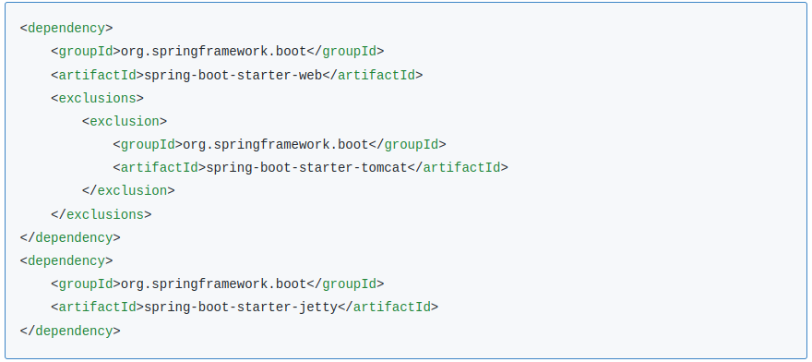

Slide 60
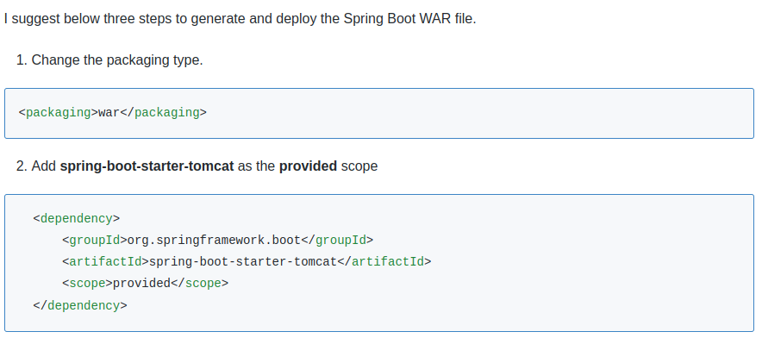
How to generate a WAR file with Spring Boot?

Slide 61
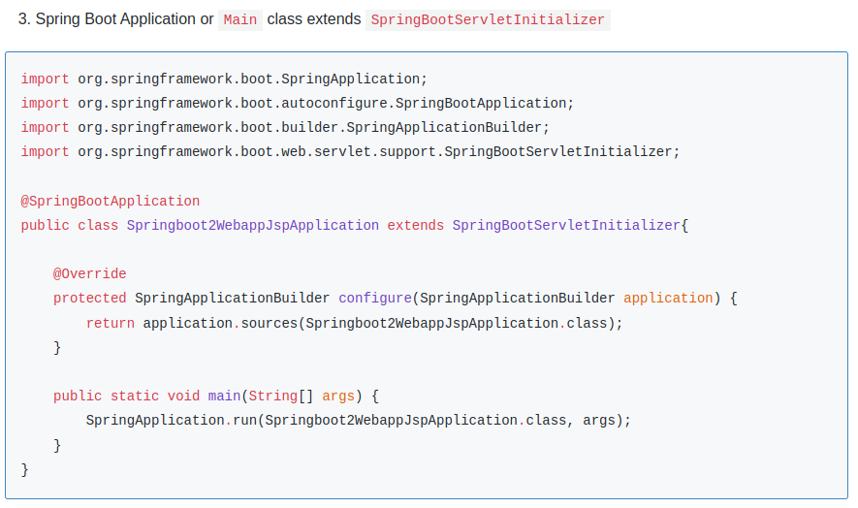

Slide 62
How many types of projects we can create using Spring boot?
We can create 3 types of projects using Spring boot starter dependencies:
If we have a spring-boot-starter dependency in a classpath then the spring boot application comes under the default category.
If we have spring-boot-starter-web dependency in a classpath then the spring boot application comes under the servlet category.
If we have a spring-boot-starter-webflux dependency in a classpath then the spring boot application comes under the reactive category.

Slide 63
How to Change Default Embedded Tomcat Server Port and Context Path in Spring Boot Application?
By default, the embedded tomcat server starts on port 8080 and by default, the context path is “/”. Now let's change the default port and context path by defining properties in an application.properties file -
/src/main/resources/application.properties
server.port=8080
server.servlet.context-path=/springboot2webapp

Slide 64
List the reasons for Spring Boot is preferred over any other framework?
It is one of the best means for configuring Java Beans.
Spring Boot offers a highly robust batch processing for managing effectively REST endpoints.
Spring boot can be integrated with the auto-configuration tool, which eliminates manual configuration, thereby speeding up development.
It offers ease in dependency management, the inclusion of embedded servlet containers, and enables annotation-based configuration.

Slide 65
List the steps to implement swagger using Spring Boot
Swagger is an open source set of rules, specs, and tools for describing and developing interactive, machine, and human-readable RESTful APIs.
@EnableSwagger2WebMvc
@Import (SpringDataRestConfig.class)
Specifications are generated for the AppUser entity with HTTP methods like GET, POST, PUT, PATCH, and DELETE.

Slide 66
How to integrate Spring Boot and Apache Kafka

Slide 67
How to integrate Spring Boot and ActiveMQ
Written in Java, Apache ActiveMQ is an open-source multi-protocol message broker with a full Java message service client.
In order to integrate Spring Boot with ActiveMQ, download and run ActiveMQ
In Maven, the dependency needed is spring-boot-starter-activemq
Create application.properties as spring.activemq.broker-url = tcp://localhost:61616
Use JMSTemplate to add new queues as ‘myqueues’

Slide 68
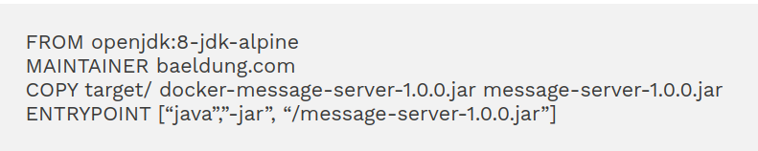
Describe steps to deploy Spring Boot to a Docker container.
Docker is a service products platform for OS-level virtualization delivering software in packages called containers.
An executable jar file will be created with a configured Maven file mvn clean package
Start up the Spring Boot application java –jar taget/docker-message-server-1.0.0.jar
To Dockerize the application, Dockerfile is created as below

Slide 69
To run ‘docker build’ like before – docker build –tag=message-server:latest
We can run the container from the image below docker run –p8887:8888 message-server:latest The above command will start the Spring Boot application in Docker, by accessing it from the host machine at localhost:8887/messages. We need to define the port mapping – mapping a port at host 8887 to a port inside Docker 8888.

Slide 70
List the steps to deploy the Spring Boot application as a WAR.
Add the spring-boot-maven-plugin plugin in pom.xml
With the above plugin, a Jar executing package phase will be generated, which will have all necessary libraries and dependencies along with the embedded server. You can run an application like an ordinary JAR file.
The packaging element in pom.xml must be set to jar to build a JAR file as <packaging>jar</packaging>
In a similar way, we can create a WAR file,
<packaging>war</packaging>

Slide 71
List the ways to enable debugging log in spring boot application.
Spring boot enable debug logging feature will display useful information related to Spring boot container initialization on a console, and check which beans have been created using which configuration.
Set debug=true or trace=true in application.properties
Set debug=true in application.yml file
pass parameter java -jar demo.jar –debug before starting the application using jar command.

Slide 72
List actuator provided endpoints for monitoring Spring boot application.
Actuator endpoints allow developers to monitor and interact with the application. There are built-in endpoints already available as well as one can create customized endpoints. We can enable or disable these endpoints as per our needs.
Configprops
Beans
Health
Httptrace
Heapdump
Threaddump
Mapping
Info
Shutdown

Slide 73
Differentiate between RequestMapping and GetMapping.
@RequestMapping | @GetMapping
Used to map web requests to specific handler classes and methods | It not used to map onto specific handler classes
It maps both GET and POST requests | It maps only GET requests
It is class level annotation | It uses get mapping annotation rather than requestmapping
Used to configure base path and not for any further levels. | It is used to overcome drawbacks of @RequestMapping
Developers avoid using this annotation due to its complexity and lengthy code | It has less code length compared to @RequestMapping

Slide 74
Differentiate between @RestController and @Controller.
@Controller annotation is used along with @RequestMapping annotation-based annotation handler methods. Their use is to mark the class as a web request handler. @Controller is used with Spring MVC applications where they are scanned to detect @RequestMapping annotations.
@RestController annotation is used for making restful web services, allowing to handle all REST API methods such as GET, POST, Delete and PUT requests. The differences between @Controller and @RequestMapping annotation are listed below

Slide 75
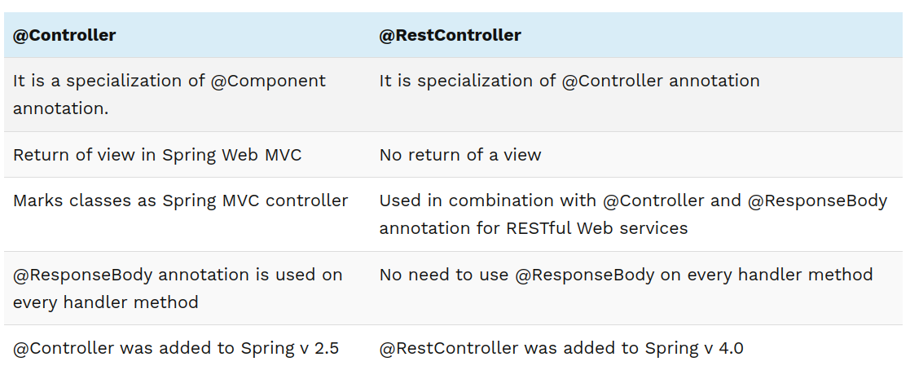

Slide 76
List some common Spring Boot Command Line commands.
spring help run This command is used to run a spring groovy script
spring version The command displays version details of the spring installed
spring test mycode.groovy welcome.groovy The test command compiles and runs the test for your application
spring jar source-code.jar *.groovy The jar created (source-code.jar) will contain all compiled classes, entries from the application’s classpath, and application dependencies that can be run using the java -jar

Slide 77
spring install com.mypack:spring-boot-cli-extension:1.0.2.RELEASE install command help add extensions in the format group:artifact: version as above
spring uninstall com.mypack:spring-boot-cli-extension:1.0.2.RELEASE uninstall command help uninstall artifacts
spring uninstall –all uninstall all dependencies using –all command

Slide 78
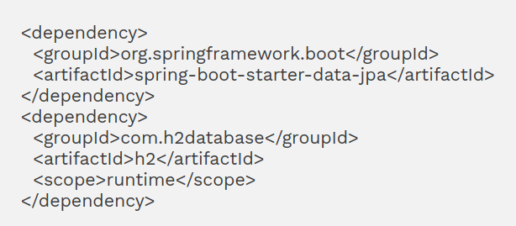
What dependencies are required to start the JPA application and connect the in-memory database H2 with Spring Boot application?
In-memory database utilizes system memory to store data instead of disk space for data storage. These databases are convenient when you don’t need data stored in physical memory.
Dependencies between the H2 database and spring-boot-starter-data-jpa are configured as below

Slide 79
The parameters listed below are added to the application.properties file as a configuration to connect to an in-memory store with a username as sa and an empty password.
spring.datasource.url=jdbc:h2:mem:sampledb
spring.datasource.driverClassName=org.h2.Driver
spring.datasource.username=sa
spring.datasource.password=
spring.jpa.database-platform=org.hibernate.dialect.H2Dialect
In addition, spring boot has two more properties to manage the h2 console, such as enable/disable database trace logs, and remote access to the H2 console by adding the following in application.properties file.
spring.h2.console.settings.trace=false
spring.h2.console.settings.web-allow-others=false

Slide 80
List the advantages of using the Spring framework.
Spring is a Java open source application development framework used for its simplicity, ease of use, safe, and quick to build enterprise applications.
The benefits of using the Spring framework are listed below:
Spring is a lightweight framework that uses plain old Java objects (POJO) and uses Tomcat as a servlet container.
Spring Beans are configured using XML or Java-based annotations.
Offers a separate class loader, different compilation, uses dependency injections to manage components and objects such as Spring Beans.

Slide 81
Spring framework offers APIs that offer easy integration with Java EE, JDK timers, and ORM frameworks.
Spring framework allows developers to pick only those classes or packages that they want to use.
The testing spring-based application is simplified using JavaBean POJO due to dependency injection.
Spring uses the MVC framework in place of the legacy web framework.
A feature like inversion control and APIs to convert JDBC or hibernate exception.

Slide 82
Why Spring boot was developed?
Spring boot was developed as an extension of Spring to overcome the limitations the Spring framework has. Spring boot uses annotation, boilerplate configuration, and reduced code length to help developers quickly deploy and create standalone Spring applications without any configuration overhead.
In addition, Spring boot also has starters that implicitly handle dependencies, embedded servers such as Tomcat and Jetty, in-memory database support, and a CLI tool for testing and developing applications.

Slide 83
List the advantages of using the Spring boot application.
Ease of development.
Standalone applications without the need for deploying war files.
Embedded servers like Tomcat, Jetty, or Undertow.
XML configuration is not needed.
Ease of starting the application.
Simple setup and management with less source code saves time building the application.
A large community for training helps solve problems during development.

Slide 84
List the features of spring boots.
Admin features: The facility enables application-wide admin-related features to remotely manage applications.
Application events and listeners: Events create a factory file to add listeners referred by the ApplicationListener key.
Externalized configuration: Use the YAML file to externalize configuration in order to use the same application in different environments.
Properties files: Use of properties file that set server-port=8082 and organizes other application properties.
YAML support: SpringApplication class alternative to properties supports YAML superset of JSON.

Slide 85
Type-safe configuration: Use annotation to validate the configuration of the application.
Security: Spring-based applications are secured by authentication at all HTTP endpoints.
Web Development: Creation of HTTP server and Spring boot starter web module using an embedded server like Jetty, Tomcat, or Undertow to quickly start and run the application.
Logging: All internal logging is captured by common logging managed by default.

Slide 86
Describe Spring boot components.
The framework is composed of the following four major components:
Starter POMs: Organizes related or common dependencies into single dependencies. Project build dependencies are simplified by Spring Boot Starter, for example – a group of database-related jar files like spring JDBC, Spring ORM, and Spring Transaction is required to add records to a database.
Auto Configurator: Spring configuration has been reduced due to Auto Configurator
Command Line Interface (CLI): Software developed by Spring Boot can run and be tested from the command prompt.
Actuators: Offer management endpoints and metrics for spring boot applications.

Slide 87
Explain Spring boot starters.
Added under pom.xml ‘s <dependencies> section, Spring boot Starters are dependency descriptors that organize dependencies of 50+ Starters under a single name.
The benefits of Spring Boot Starters are as listed below:
Reduced configuration time, thereby increasing productivity for developers.
Less number of added dependencies makes ease managing the Page Object Model (POM).
Dependency configurations are well supported, tested, and ready for production.
No need to remember the version and name of the dependencies.

Slide 88
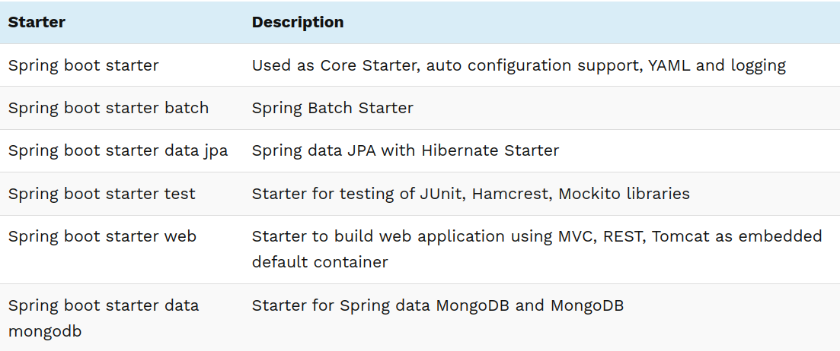
List popularly used Spring boot starters.

Slide 89
What system pre-requisites are needed for developing a spring boot 2 application?
The system requirement for Spring Boot version 2.1.13 application development needs
Java 8 (compatible up to Java 12).
Spring Framework 5.2.14 or above
Build Tools like Gradle 4.4 and higher or Maven 3.3 and higher.
Embedded servlet containers such as Tomcat 9.0 with servlet version 4 or Jetty 9.4 with servlet version 3.1 or Undertow 2.0 with servlet version 4.0.
Followed by Spring Boot CLI (command line interface)

Slide 90
Describe Thymeleaf and its use.
The server-side template engine developed in Java, Thymeleaf is used along with Spring Boot for standalone and web environments. The template is capable of processing plain text, HTML, JavaScript, CSS, XML, and Raw. Thymeleaf provides an elegant, maintainable way of creating templates.
Thymeleaf fully integrates with the Spring framework, providing a well-formed way of creating templates. Many reputed organizations like HCL Technologies, Nokia Networks, University of Cambridge, JP Morgan, Canada Life, Deutsche Bank, etc. use Thymeleaf template in their web applications.

Slide 91
Explain the need for Spring boot DevTools.
Spring Boot Developer Tool is utilized to improve development time while working with the Spring Boot application.
Automatic Restart of an application: With DevTools, a developer can make changes in the properties file or Java source code for updates and restarts the application.
Template Cache disabled automatically: Spring Boot offers various template options like Groovy, FreeMarker and Thymeleaf configured to cache the results of parsing automatically. Due to this, it becomes difficult to make changes in templates while running the application.
DevTools automatically disables all template caching. The changes will reflect only after browser refresh.
Automatic browser refresh: With DevTools embedded with an application, ‘LiveReload’ server is enabled, making your browser automatically refresh whenever changes in CSS stylesheets, JavaScript, Template engine, etc. are done.
H2 database console: Adding H2 database dependency to the build, DevTools will enable the H2 console automatically

Slide 92
List the steps to use JDBC for spring boot application connect with the database.
Creating a Database
Creating Spring Boot Project spring-boot-starter-jdbc mysql-connector-java
Database Connection properties configuration spring.datasource.url=jdbc:mysql://localhost:3306/library spring.datasource.username=root spring.datasource.password=password
Create Java Model Class
Creation of Spring Boot JDBC application.
Execute as Java application
Verify (localhost: 8080/Insert), to find the Data entry operation successful.

Slide 93
Explain @RestController annotation in Spring Boot.
@RestController annotation gives information on routing by mapping any HTTP request to the corresponding Spring method. In order to implement this annotation, import org.springframework.web.annotation package in the spring application.
All REST API methods in the Spring framework such as GET, POST, PUT, and Delete requests, are handled by @RestController annotation and are useful in creating RESTful web services.

Slide 94
Describe @RequestMapping annotation in Spring Boot.
@RequestMapping annotation is used for the controller from both – class level and/or method level. The annotation maps a specific pattern or request path onto a controller. In addition, more mappings specific to handler methods are applied by method-level annotation.

Slide 95
Explain auto-configuration in spring boot and list the steps to disable auto-configuration?
Auto-configuration in spring boot is used for
Checking dependencies
Verify the presence of certain classes in the classpath
Presence of bean
Activation of some property
Auto-configuration can be disabled in the following ways:
Using Annotation
Using the property file
Using exclude attribute of @EnableAutoConfiguration

Slide 96
List the advantages and ways to load the YAML file instead of the properties file in the Spring Boot application.
YAML stands for “YAML Ain’t Markup language” and has the following properties:
Human-friendly, provide more clarity
Suitable for hierarchical data configuration
Support for enhancing maps, lists, and scalar types.
There are two classes from the spring framework that extend YamlProcessor, that are used to load YAML documents.
YamlPropertiesFactoryBean class can load YAML as properties
YamlMapFactoryBean class will load YAML as Map

